Slide 1
Tic Tac Toy Project

Slide 2
Introduction
The Tic Tac Toe project is a simple implementation of the classic Tic Tac Toe game on the Android platform. The purpose of the project is to provide a fun and interactive game for users to play on their Android devices. The objectives of the project are to create a functioning Tic Tac Toe game that can be easily played, and to provide a good user experience for the players. The scope of the project includes the development of the Tic Tac Toe game on the Android platform.

Slide 3
Background
Tic Tac Toe is a popular game that has been played for many generations. The game is a two-player game where each player takes turns marking a square on a 3x3 grid with their symbol (X or O). The goal of the game is to place three of your symbols in a row, either horizontally, vertically, or diagonally. The game ends when all nine squares are filled or when one player gets three of their symbols in a row.

Slide 4
System Analysis
The requirements analysis for the Tic Tac Toe project included both functional and non-functional requirements. The functional requirements included the ability to play a game of Tic Tac Toe, to switch between X and O players, to determine a winner, and to restart the game. The non-functional requirements included the ability to have an attractive and user-friendly interface, and to provide a smooth and responsive game experience. The requirements were elicited through discussions with potential users and through an analysis of similar games. The requirements were then validated through testing and feedback from users.

Slide 5
Design
The software design of the Tic Tac Toe project included an architecture that consisted of several components, including the main game screen, the game logic, and the user interface. The component design focused on creating a clear and modular design that would allow for easy maintenance and modification of the code. The interface design focused on creating an attractive and user-friendly interface that would provide a good user experience. The design decisions were made with a focus on simplicity and ease of use.

Slide 6
Implementation
The Tic Tac Toe project was implemented using Java and the Android Studio development environment. Several libraries and tools were used to help with the implementation, including the Android SDK and the Android support libraries. The overall software development process followed a iterative approach, with regular testing and feedback from users.

Slide 7
Testing
The testing of the Tic Tac Toe project included both functional and non-functional testing. The functional testing included testing the game logic and the ability to play a complete game of Tic Tac Toe. The non-functional testing included testing the user interface, performance, and overall user experience. The testing was performed through manual testing and feedback from users. The methods used to verify the software's functionality and reliability included regular testing, code reviews, and user feedback.

Slide 8
Maintenance
The maintenance and support plan for the Tic Tac Toe project includes regular updates to the game logic and user interface to ensure that the game continues to operate correctly over time. In addition, the code will be regularly reviewed and tested to ensure that it is maintainable and secure.

Slide 9
Conclusion
The Tic Tac Toe project is a simple and fun implementation of the classic Tic Tac Toe game on the Android platform. The project has achieved its objectives by providing a functioning game that is easy to play and provides a good user experience. The contributions of the project include a new implementation of the Tic Tac Toe game on the Android platform, and an attractive and user-friendly user interface.

Slide 10
Screen Shotes

Slide 11
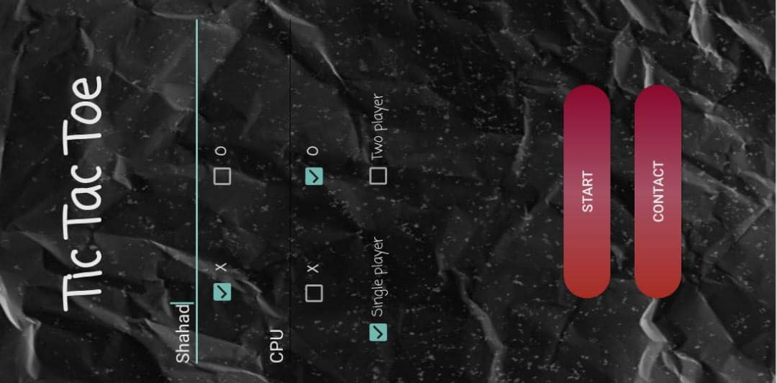
Home

Slide 12
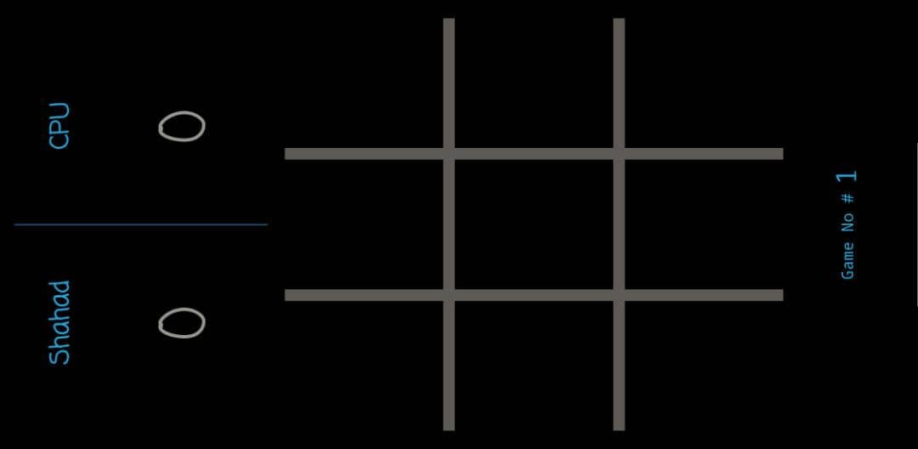
Second Screen

Slide 13
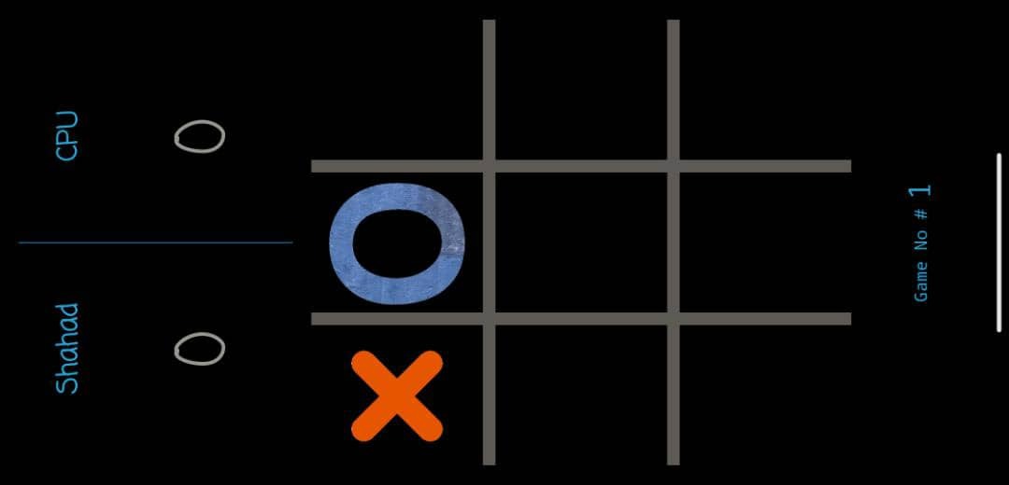
Third Screen

Slide 14
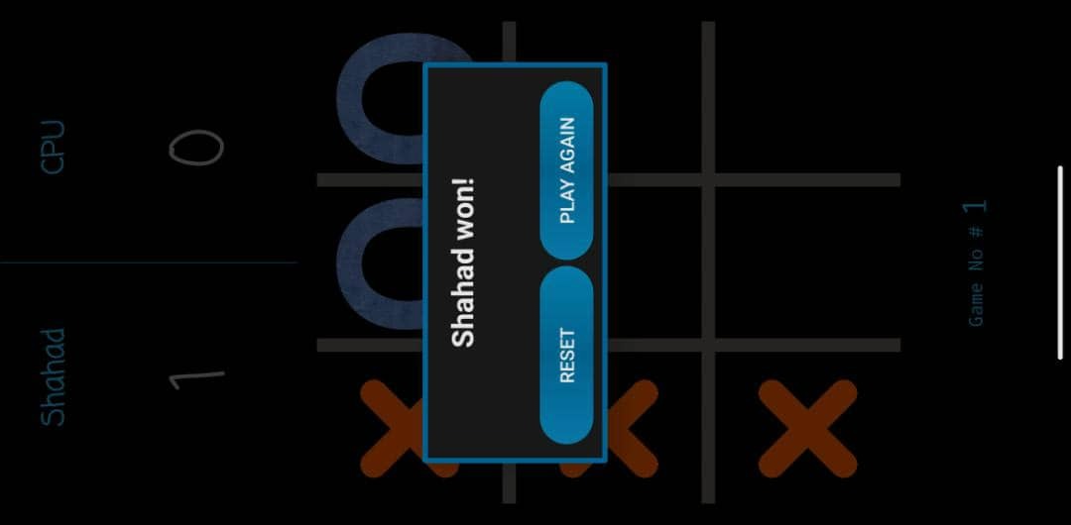
Fourth Screen

Slide 15
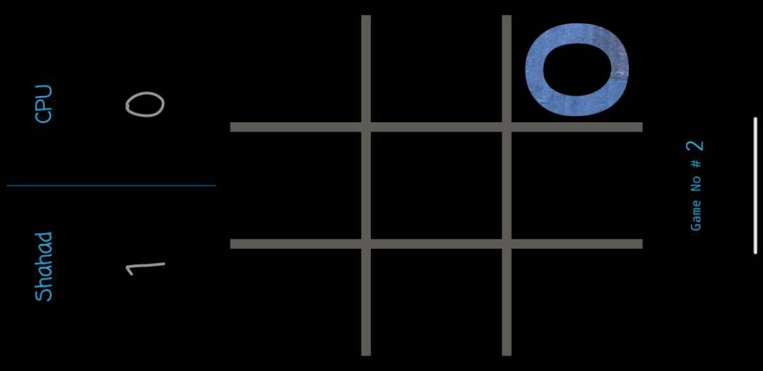
Fifth Screen

Slide 16
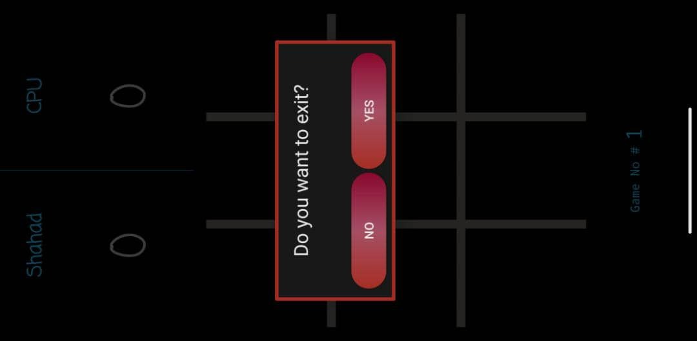
Sixth Screen

Slide 17
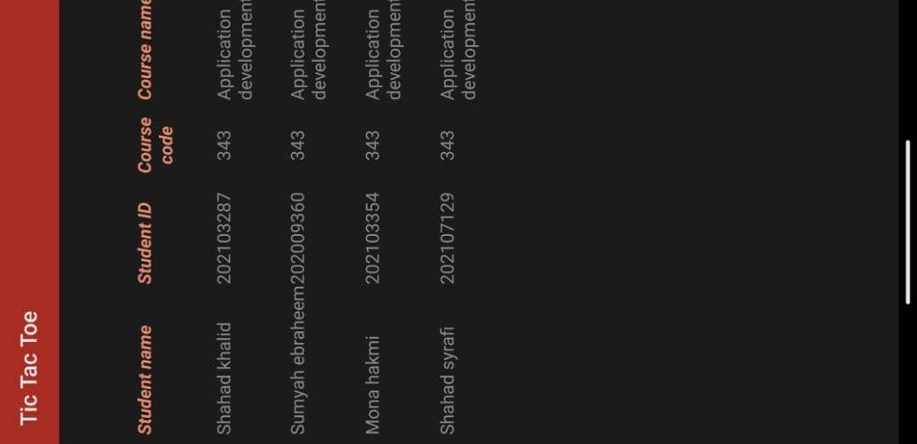
Contact Screen

